Slide 1
Decoder

Slide 2
Decoder
2-to-4,
3-to-8,
…
n-to-2^{n}
E
A
B
C
O₀
O₁
O₂
O₃
O₄
O₅
O₆
O₇
0
X
X
X
0
0
0
0
0
0
0
0
O₀
ABC
O₁
ABC
1
0
0
0
1
0
0
0
0
0
0
0
A
S₂
O₂
ABC
1
0
0
1
0
1
0
0
0
0
0
0
B
S₁
3:8
O₃
ABC
1
0
1
0
0
0
1
0
0
0
0
0
C
dec
O₄
ABC
S₀
1
0
1
1
0
0
0
1
0
0
0
0
O₅
ABC
O₆
ABC
1
1
0
0
0
0
0
0
1
0
0
0
O₇
ABC
1
1
0
1
0
0
0
0
0
1
0
0
1
1
1
0
0
0
0
0
0
0
1
0
1
1
1
1
0
0
0
0
0
0
0
1
Enb

Slide 3
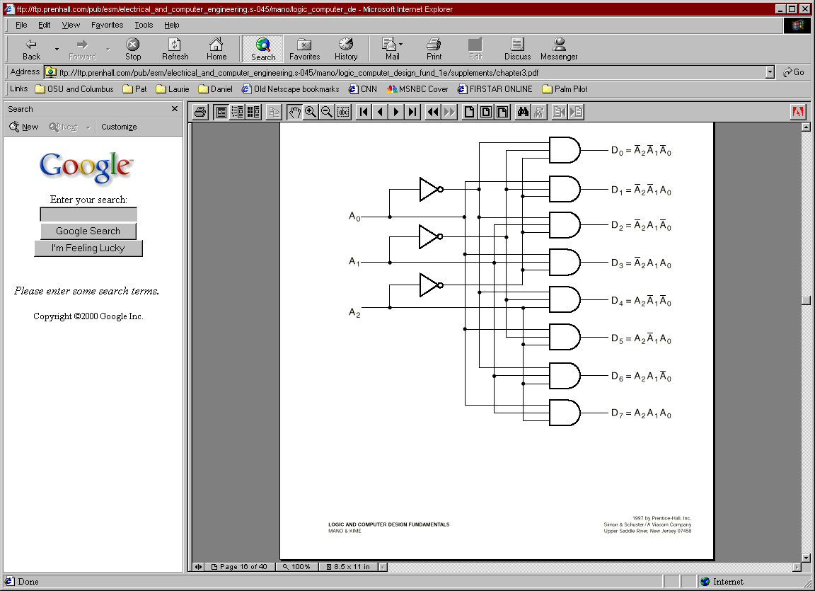
Decoder
E?

Slide 4
Design Using Decoder
Applications:
Implementing General Logic
Any combinational circuit can be constructed using decoders and OR gates!
Example:
0
1
F1 = A' B C' D + A' B' C D + A B C D
F2 = A B C' D' + A B C
F3 = (A' + B' + C' + D')
2
3
A
S₃
4
S₂
5
B
6
4:16
7
C
S₁
dec
8
9
D
S₀
10
1
1
12
13
14
15
Enb

Slide 5
Design Using Decoder
Applications:
Implementing General Logic
Any combinational circuit can be constructed using decoders and OR gates!
Example:
0
A
‘B’C’D’
1
A
‘B’C’D
F
F1 = A' B C' D + A' B' C D + A B C D
F2 = A B C' D' + A B C
F3 = (A' + B' + C' + D')
2
A
‘B’CD’
1
3
A
‘B’CD
A
S₃
4
A
‘BC’D’
S₂
5
A
‘BC’D
B
6
A
‘BCD’
4:16
7
A
‘ BCD
C
S₁
dec
8
A
B’C’D’
F
9
A
B’C’D
2
D
S₀
10
A
B’CD’
1
1
A
B’CD
12
A
B C’D’
13
A
B C’D
14
A
B C D’
F
15
A
B C D
3
Enb

Slide 6
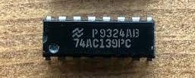
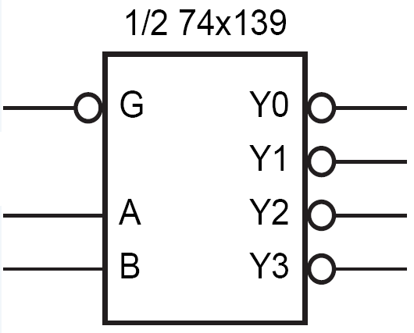
Active Low
Decoder with
Active Low Enable
Active Low Outputs
G | A | B | Y₀ | Y₁ | Y₂ | Y₃
1 | X | X | 1 | 1 | 1 | 1
0 | 0 | 0 | 0 | 1 | 1 | 1
0 | 0 | 1 | 1 | 0 | 1 | 1
0 | 1 | 0 | 1 | 1 | 0 | 1
0 | 1 | 1 | 1 | 1 | 1 | 0

Slide 7
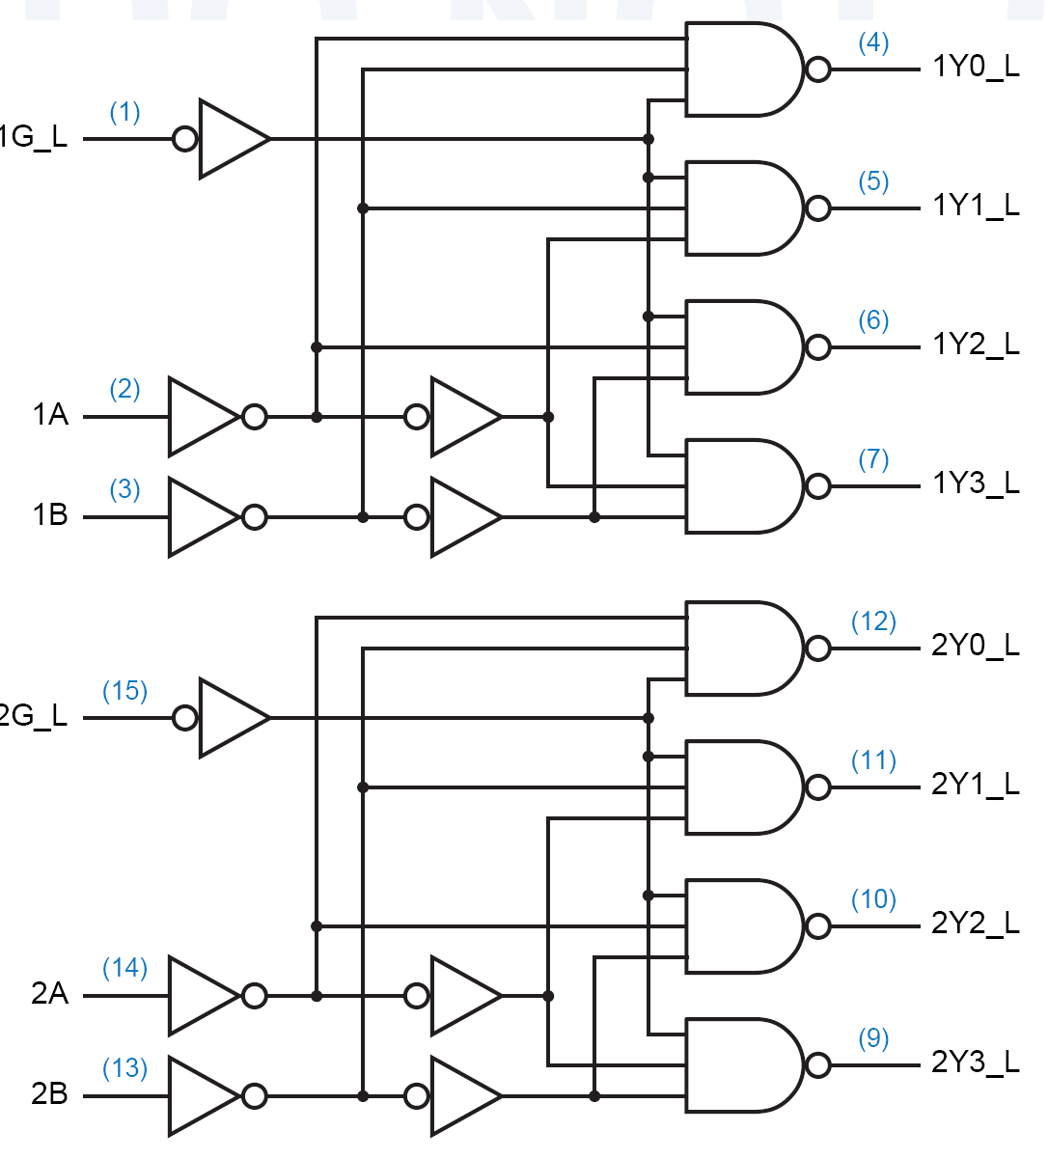
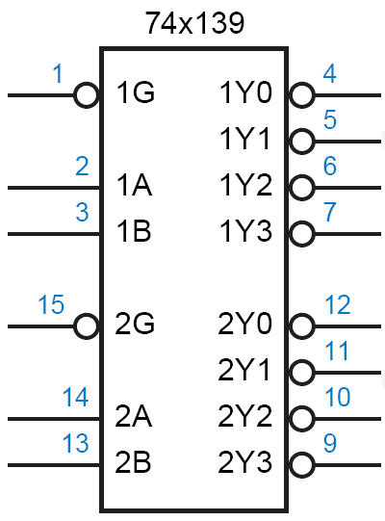
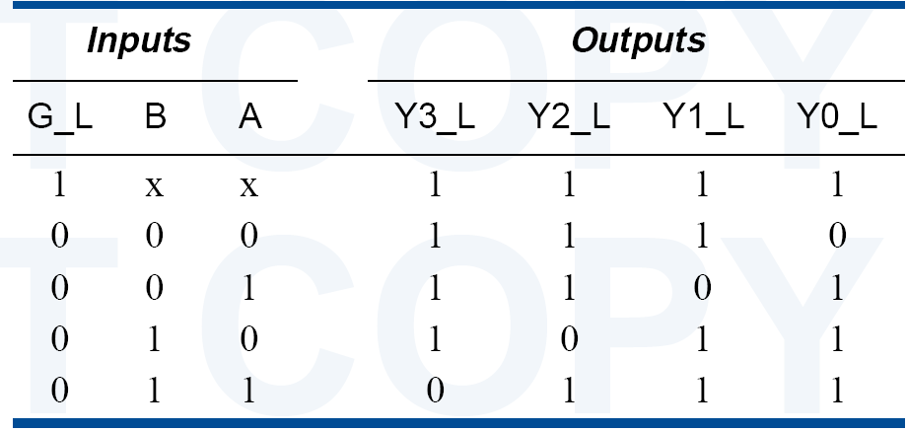
74x139 dual 2-to-4 decoder

Slide 8
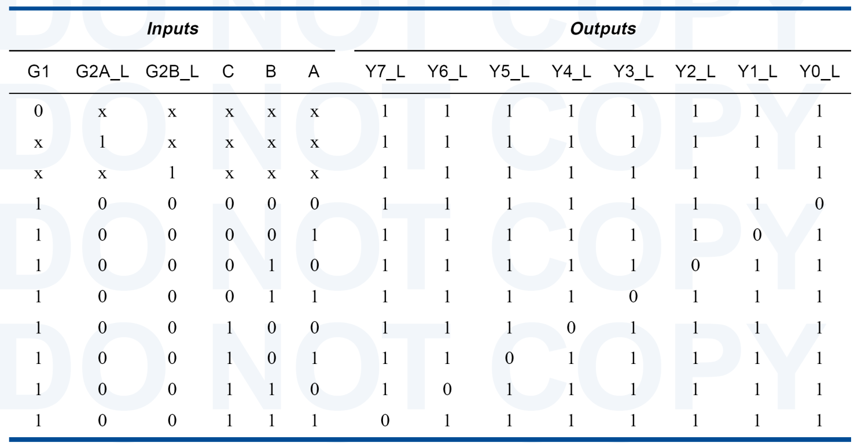
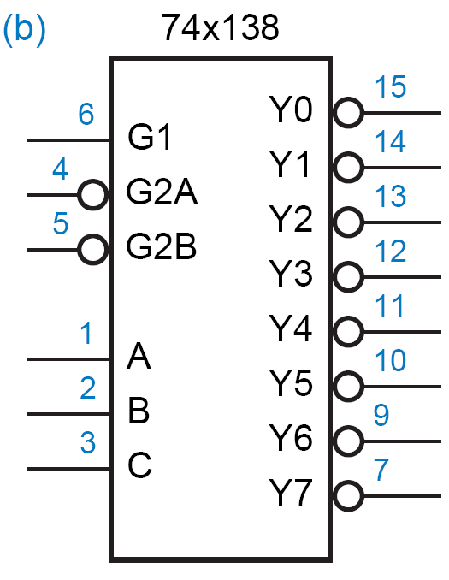
74x138 3-8 Decoder

Slide 9
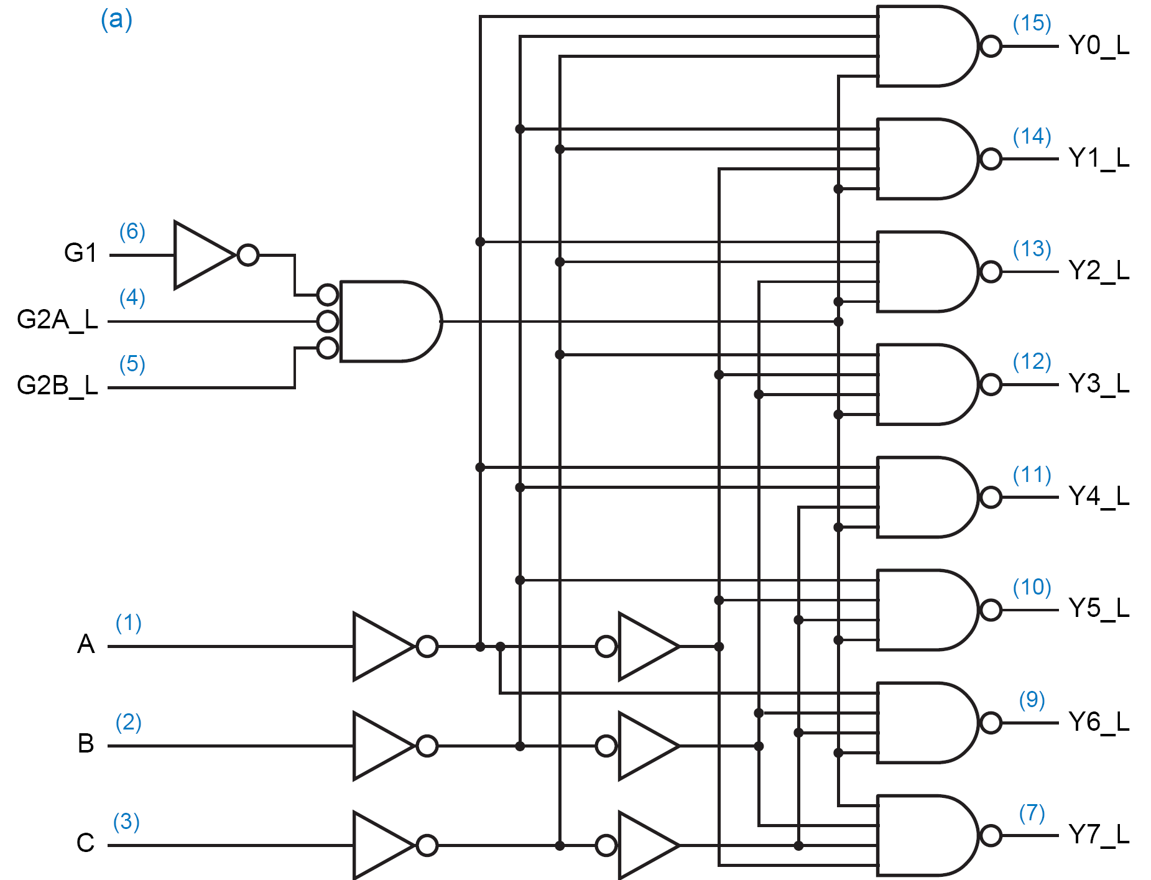
74x138 3-8 Decoder

Slide 10
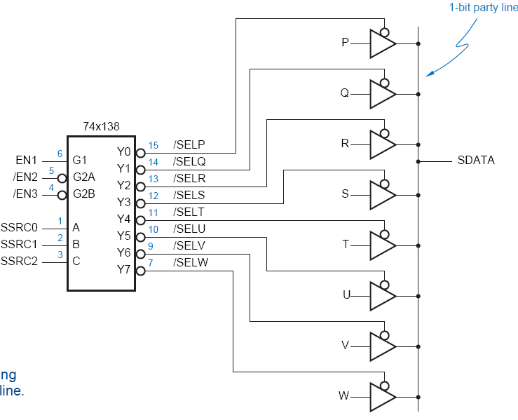
Using 3-State Buffers
Can use 3-state buffers to share a single line for several devices.
Decoder guarantees that no two buffers are on simultaneously.

Slide 11
Decoders
Can build a decoder by smaller decoders
A
O₀
0
S₂
O₁
1
B
S₁
O₂
3:8
O₃
2
S₀
dec
O₄
3
O₅
A
S₃
4
O₆
5
Enb
O₇
B
S₂
6
4:16
7
C
S₁
dec
8
C
9
O₀
D
S₀
10
S₂
O₁
1
1
O₂
12
S₁
3:8
O₃
13
S₀
dec
O₄
14
O₅
15
D
Enb
O₆
O₇
Enb

Slide 12
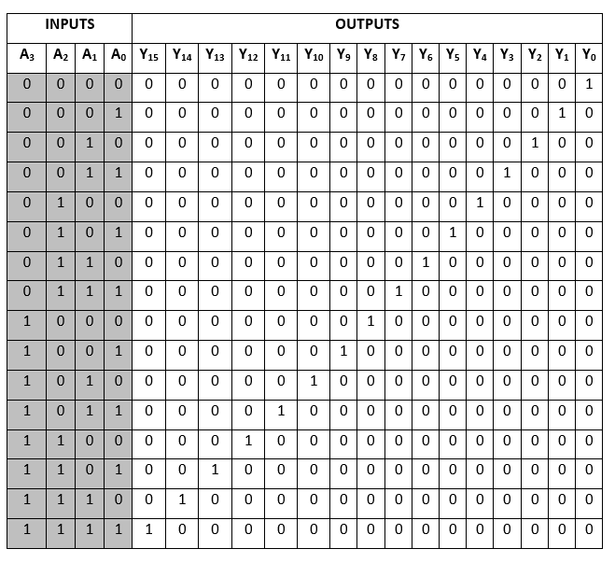
Decoders

Slide 13
Decoders
Can build a decoder by smaller decoders
A
O₀
0
B
S₂
O₁
1
B
C
S₁
O₂
3:8
O₃
2
D
S₀
dec
O₄
3
O₅
A
S₃
4
O₆
5
Enb
O₇
B
S₂
6
4:16
7
C
S₁
dec
8
C
9
O₀
D
S₀
10
B
S₂
O₁
1
1
O₂
12
C
S₁
3:8
O₃
13
D
S₀
dec
O₄
14
O₅
15
D
Enb
O₆
O₇
Enb

Slide 14
Decoders
How to build a 5-32 decoder by using 4-16 and 2-4 decoders?

Slide 15
Decoders
Decoder: a more general term
Our focus was on “binary decoders”

Slide 16
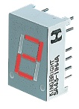
7-Segment Decoder
Seven-segment display:
7 LEDs (light emitting diodes), each one controlled by an input
1 means “on”, 0 means “off”
Display digit “3”?
Set a, b, c, d, g to 1
Set e, f to 0
a
f
b
g
e
c
d

Slide 17
7-Segment Decoder
C
0
C
C
5
C
6
1
C
C
4
2
C
3
C
C
C
C
C
C
C
0
1
2
3
4
5
6
BCD-to-7-segment
control signal
decoder
A
B
C
D

Slide 18
7-Segment Decoder
7-Segment Decoder:
Input is a 4-bit BCD code → 4 inputs (A, B, C, D).
Output is a 7-bit code (a,b,c,d,e,f,g) that allows for the decimal equivalent to be displayed.
Example:
Input: 0000_{BCD}
Output: 1111110 (a=b=c=d=e=f=1, g=0)
a
f
b
g
e
c
d

Slide 19
BCD-to-7Segment Truth Table
Digit
ABCD
abcdefg
Digit
ABCD
abcdefg
0
0000
1111110
8
1000
1111111
1
0001
0110000
9
1001
111X011
1010
XXXXXXX
2
0010
1101101
1011
XXXXXXX
3
0011
1111001
1100
XXXXXXX
4
0100
0110011
1101
XXXXXXX
5
0101
1011011
1110
XXXXXXX
6
0110
X011111
1111
XXXXXXX
7
0111
11100X0

Slide 20
K-maps
AB
A
AB
A
AB
A
CD
00
01
11
10
CD
00
01
11
10
CD
00
01
11
10
00
1
0
X
1
00
1
1
X
1
00
1
1
X
1
01
0
1
X
1
01
1
0
X
1
01
1
1
X
1
D
D
D
11
1
1
X
X
11
1
1
X
X
11
1
1
X
X
C
C
C
10
1
1
X
X
10
1
0
X
X
10
0
1
X
X
B
B
B
K-map for
a
K-map for
b
K-map for
c
A
AB
A
AB
A
AB
A
AB
CD
00
01
11
10
CD
00
01
11
10
CD
00
01
11
10
CD
00
01
11
10
00
1
0
X
1
00
1
0
X
1
00
1
1
X
1
00
0
1
X
1
01
0
1
X
0
01
0
0
X
0
01
0
1
X
1
01
0
1
X
1
D
D
D
D
11
1
0
X
X
11
0
0
X
X
11
0
0
X
X
11
1
0
X
X
C
C
C
C
10
1
1
X
X
10
1
1
X
X
10
0
1
X
X
10
1
1
X
X
B
B
B
B
K-map for
d
K-map for
e
K-map for
f
K-map for
g
a = A + B D + C + B' D'
b = A + C' D' + C D + B'
c = A + B + C' + D
d = B' D' + C D' + B C' D + B' C
e = B' D' + C D
f = A + C' D' + B D' + B C'
g = A + C D' + B C' + B' C

Slide 21
Encoder

Slide 22
Encoder
Encoder:
Inverse operation of a decoder
Has 2^{n} input lines and n output lines.
The output lines generate the binary equivalent of the input line whose value is 1.
I0
z1
4-2
Binary
Encoder
I1
I2
z2
I3

Slide 23
Encoder
O₀
I₀
A
S₂
O₁
I₁
Z₂
A
O₂
I₂
B
S₁
3:8
O₃
I₃
8:3
Z₁
B
C
decoder
O₄
I₄
encoder
C
S₀
Z₀
O₅
I₅
O₆
I₆
O₇
I₇

Slide 24
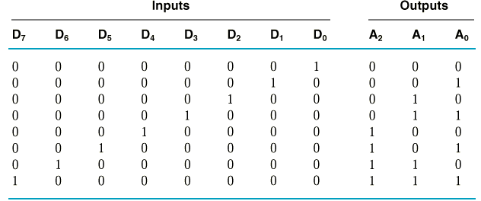
Encoder Circuit Design
Example:
8-3 Binary Encoder
A₀ = D₁ + D₃ + D₅ + D₇
A₁ = D₂ + D₃ + D₆ + D₇
A₂ = D₄ + D₅ + D₆ + D₇

Slide 25
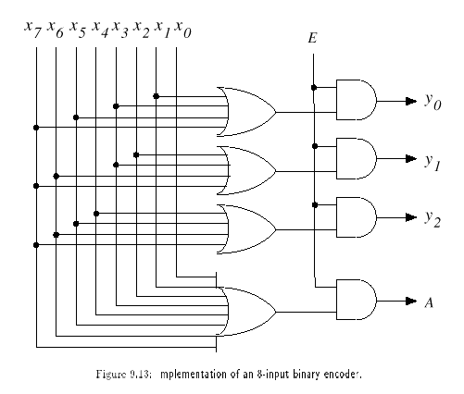
Encoder Circuit
With Enable
With Acknowledge

Slide 26
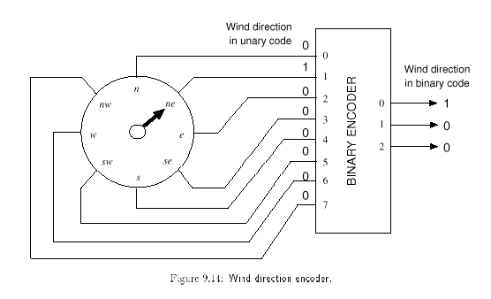
Application
The number of inputs: large
→ fewer lines

Slide 27
Encoder Design Issues
Only one input can be active at any given time.
If two inputs are active simultaneously, the output produces an undefined combination
(for example, if D₃ and D₆ are 1 simultaneously, the output of the encoder will be 111.
A₀ = D₁ + D₃ + D₅ + D₇
A₁ = D₂ + D₃ + D₆ + D₇
A₂ = D₄ + D₅ + D₆ + D₇

Slide 28
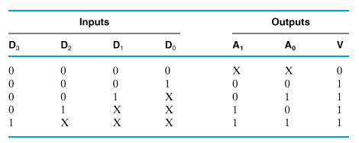
Priority Encoder
Multiple asserted inputs are allowed; one has priority over all others.

Slide 29
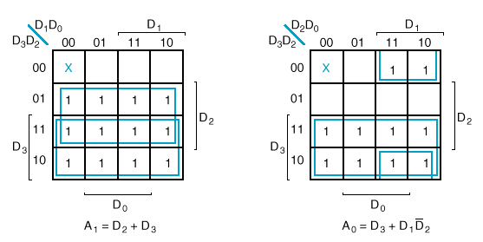
K-Maps

Slide 30
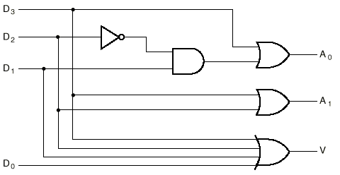
Circuit

Slide 31
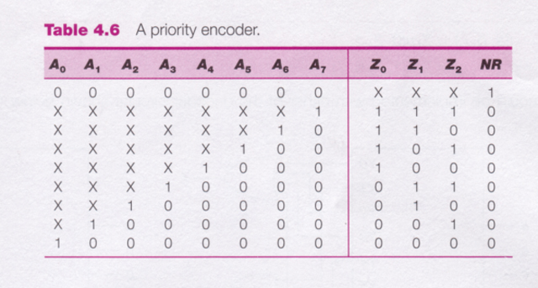
8-3 Priority Encoder

Slide 32
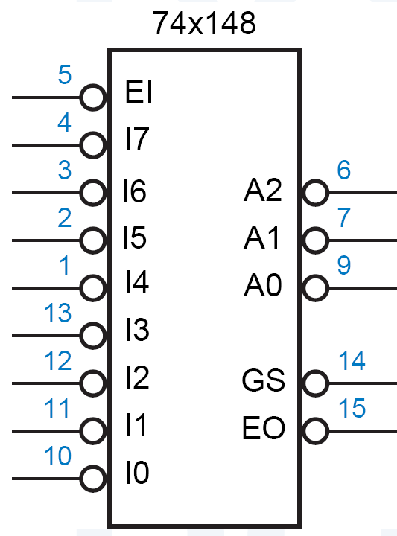
74x148
Features:
inputs and outputs are active low.
EI_L must be asserted for any of its outputs to be asserted.
GS_L is asserted when the device is enabled and one or more of the request inputs is asserted. (“Group Select” or “Got Something.” )
EO_L is an enable output designed to be connected to the EI_L input of another ’148 that handles lower-priority requests.
It is asserted if EI_L is asserted but no request input is asserted; thus, a lower-priority ’148 may be enabled.

Slide 33
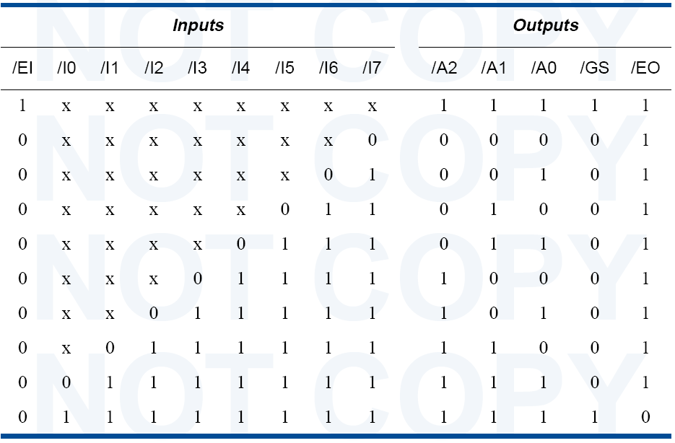
74x148 Truth Table

Slide 34
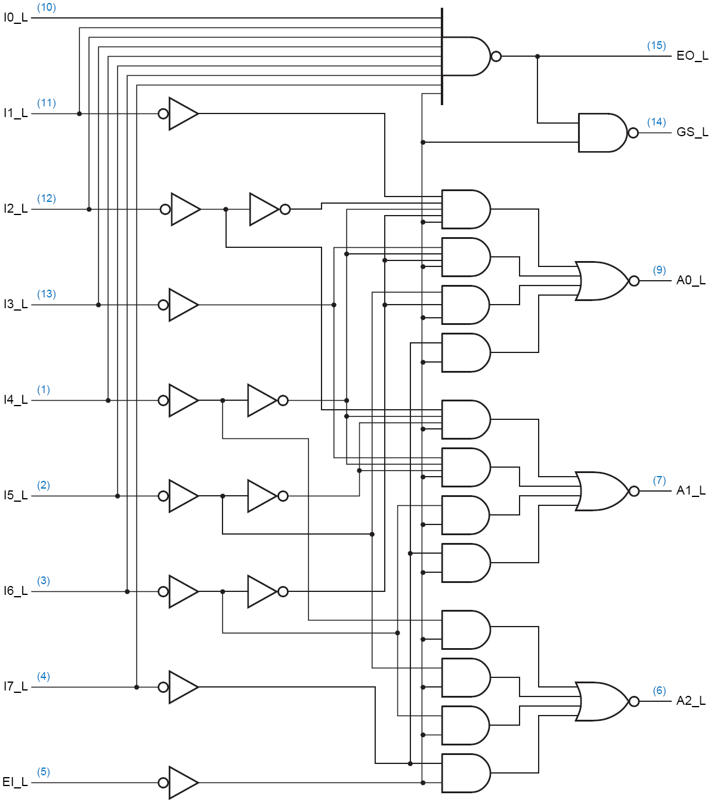
Circuit Diagram

Slide 35
Datasheets
Search for datasheets and read some of them.

